Slide 1

Home Value Changes
Predictive model

Slide 2
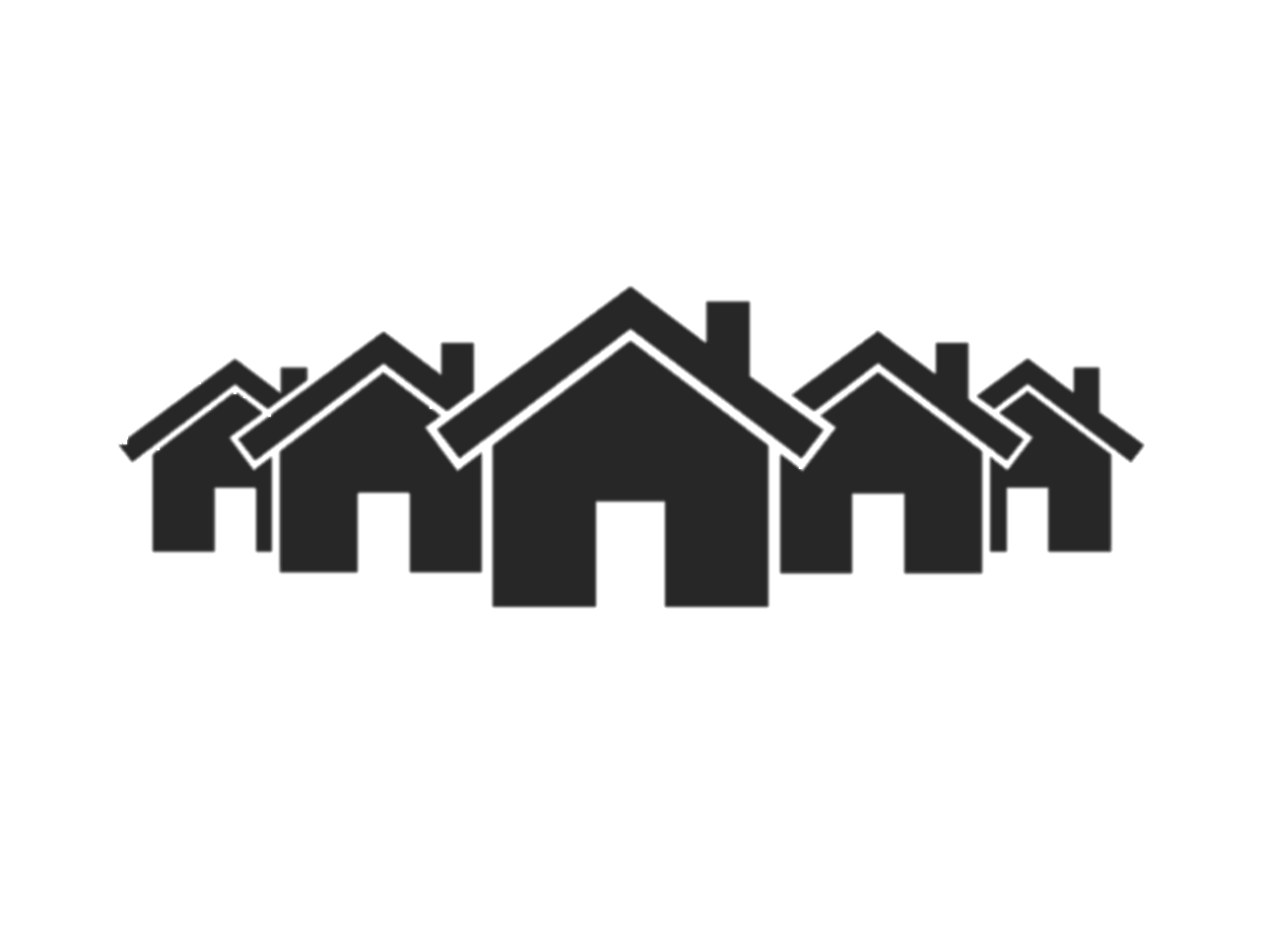
Overview
Objective | Develop a predictive model for the short-term change in home price value in metro areas across the United States.
Data used | Market data from Zillow Job opening statistics from the Bureau of Labor Statistics (BLS) Gross Domestic Product (GDP), population and personal income statistics from the Bureau of Economic Analysis (BEA)
Output
.26%
mean absolute error
94%
recall
(true decline)
81%
specificity
(true increase)

Slide 3
Problem
Background | Many home buyers and sellers are considering entering the market Market participants want to understand short term outlook
Requirement
Details | Zillow HVI Measures the typical home value for 35th - 65th percentile Predicted monthly for metro areas | Estimation period One month gives time to consider urgency for market related activities Consider magnitude and direction
HVI
predict Zillow home value index
+1
one month lookahead

Slide 4
Approach: Data wrangling
Source | Statistics | Availability | Frequency | Level of detail
Zillow | Home value index Rent For sale inventory Percent of sales above/below listing Median days to close New constructions Percent of listings with pricecut | 2000 - present | Monthly | Metro
 | Home value index | 2000 - present | Monthly | State
Bureau of Labor Statistics (BLS) | Number of job openings Number of job openings seasonally adjusted | 2004 - present | Monthly | State
Bureau of Economic Analysis (BEA) | Personal income Per capita personal income Population Current dollar GDP | 2000 - present | Quarterly | State

Slide 5
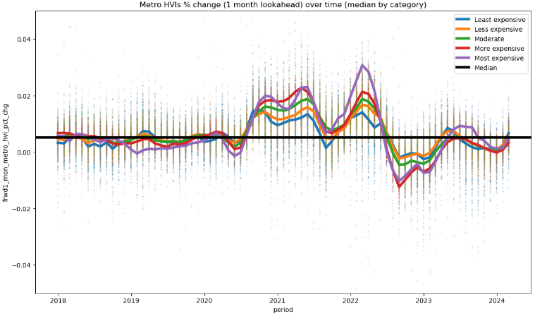
Approach: EDA/preprocessing
Aggregation | Join all datasets on state One observation per metro per period Forward fill missing periods
Lag features | Target: Add metro HVI from the next period to include future HVI and percentage change in HVI More features: Add all features from the previous 1, 2, 3 and 6 periods to include raw amounts and percentage changes
What is being predicted?
The change in metro HVI from the current period to the next period is the target variable

Slide 6
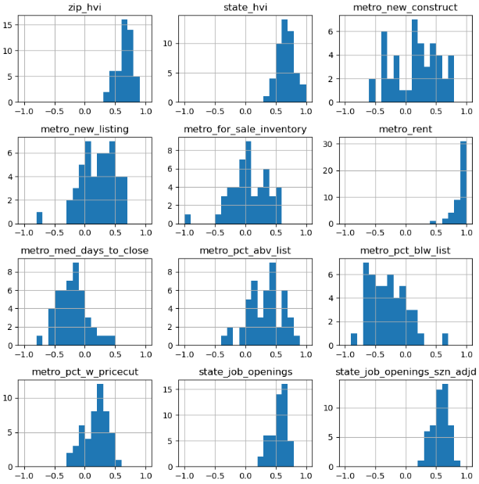
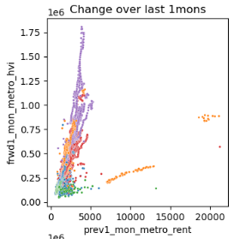
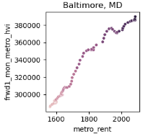
Approach: EDA/preprocessing
Aggregate analysis | No strong linear relationships were identified in aggregate for the population. Relationships appear at individual state and metro levels.
State by state analysis | Correlation between each independent variable and metro HVI was measured using the correlation coefficient
 | Metric correlation

Slide 7
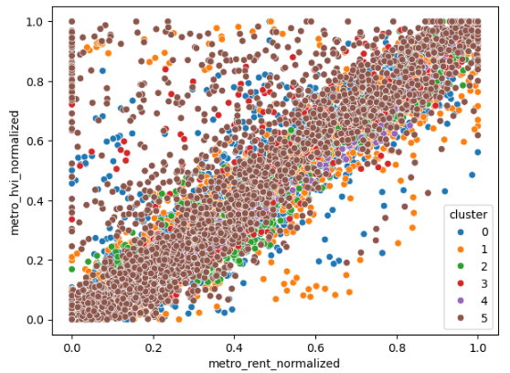
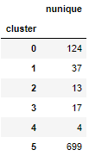
Approach: EDA/preprocessing
Clustering | Kmeans model used to cluster metros Subset of variables used for clustering Home value New constructions Rent Job openings Personal income Population
Normalization | Minmax scaler used on the initial independent variables Scale amounts in each variable from 0 to 1 (separately for each metro) Variance retained
Impact of normalization
Linear relationships are seen in the normalized personal income, job openings, and sales below listing. Rent provides the strongest linear relationship of all variables.

Slide 8
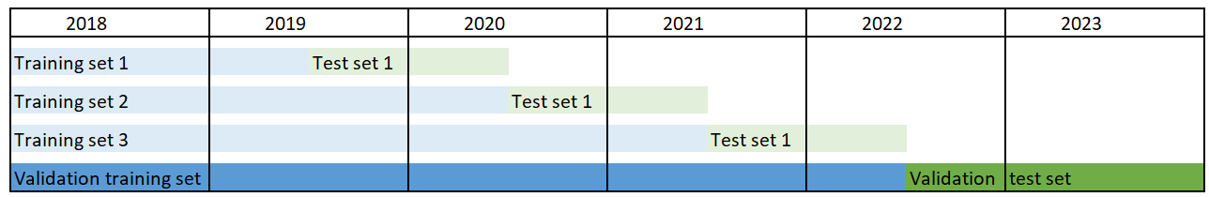
Approach: Model selection
Cross validation | Variable sets 0: All engineered features 1: All normalized amounts from the current period, 1 month lag features and all lag periods for hvi, rent, job opening change percent, population change percent and personal income change percent. 2: All normalized amounts from the current period and all percentage change lag amounts. | Datasets
Performance Metrics
Regression (Magnitude) | Mean absolute error (Primary metric) Provides score of the average different between prediction and actual amount in same unit as target variable
Classification (Direction) | Recall (Secondary metric) Percentage of actual decreases in value where a decrease was predicted Precision (Secondary metric) Percentage of actual increases in value where an increase was predicted

Slide 9
Approach: Model selection
Baseline | Mean change in home value for each metro area used as the predicted value Okay results
Gradient Boosting | Tested 15 randomly selected sets of parameters for each set of variables Better results
Random Forest | Tested 15 randomly selected sets of parameters for each set of variables Best results
.62%
mean absolute error
30%
recall
(true decline)
93%
specificity
(true increase)
.32%
mean absolute error
60%
recall
(true decline)
97%
specificity
(true increase)
.29%
mean absolute error
48%
recall
(true decline)
98%
specificity
(true increase)

Slide 10
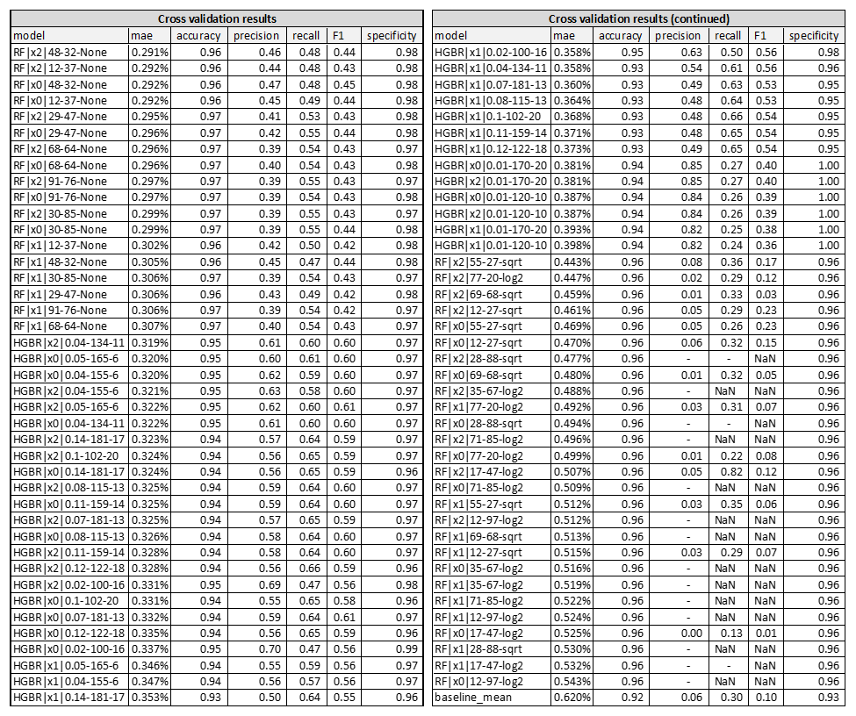
Cross Validation Results

Slide 11
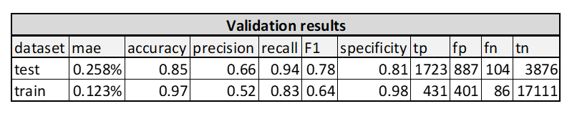
Validation
Selected model | Random forest model with following parameters gave the strongest performance: Variable set = 2 (all pct change lag and normalized amounts for current period) Number of estimators = 48 Minimum samples per leaf = 32 Maximum features = None
Validation | The validation test predicted the percentage of home value change within 41% of one standard deviation of the actual home value change for the test period. Out of the 1,827 observations where home value declined, the model correctly predicted a decline 94.3% of the time (recall). Out of the 2,610 observations where the model predicted a decline, only 66% of the time did a decline actually occur (precision). Out of the 4,763 observations where home value increased, the model correctly predicted an increase 81.4% of the time (specificity).
Validation test results

Slide 12
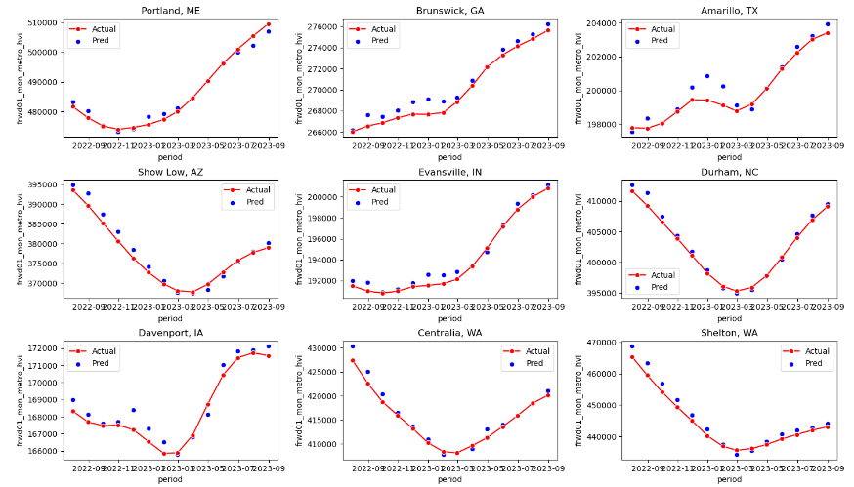
Findings: Model results
Random examples: Home value prediction | Predicted HVI compared to actual

Slide 13
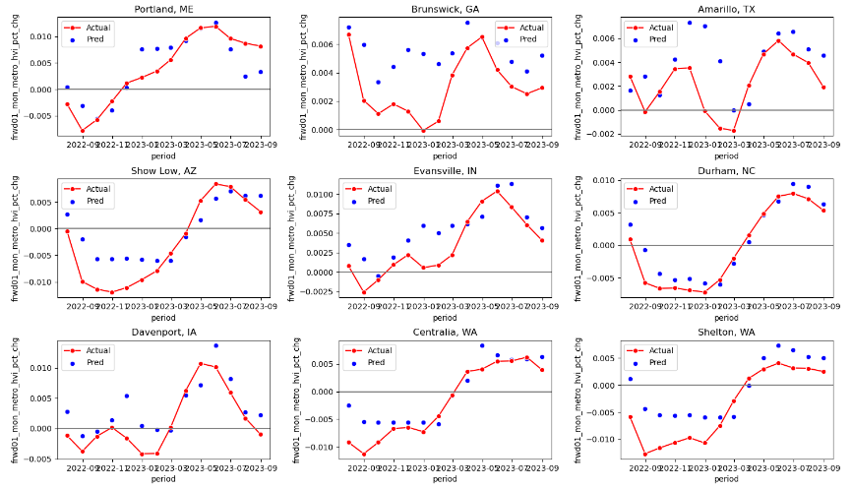
Findings: Model results
Random examples: Home value change prediction | Predicted HVI change compared to actual

Slide 14



Use cases
Realtor | Provide free access to this model on their website Drive traffic from anyone in U.S. single-family home market
Prospective buyers | Accelerate or decelerate planned purchase based on expected market direction Use expected decrease to negotiate lower purchase price
Prospective sellers | Accelerate or decelerate marketing based on expected market direction Use time from expected increase to undertake small projects to further increase home value within the market

Slide 15
What’s next?
1 | Reviewing the prediction period to determine how far into the future a reasonable level of accuracy can be maintained.
2 | Adding features from additional data sources such as demographic and housing estimates from the US Census Bureau.
3 | Additional feature standardization to be explored.
4 | Additional models will be explored to determine if the existing model still provides best performance with additional data sources.

